Slide 1
Fire Hazard Severity Zones
August 2024
El Cerrito-Kensington Fire Department

Slide 2
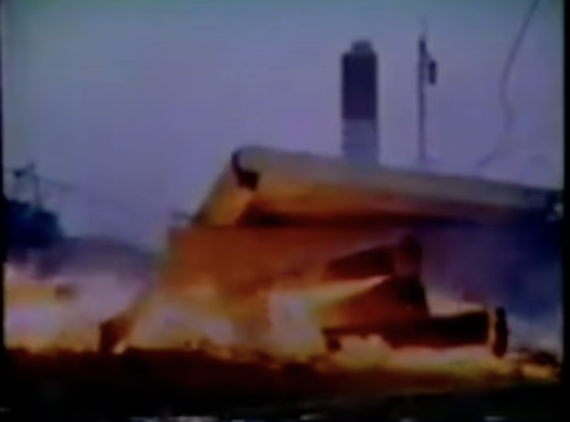
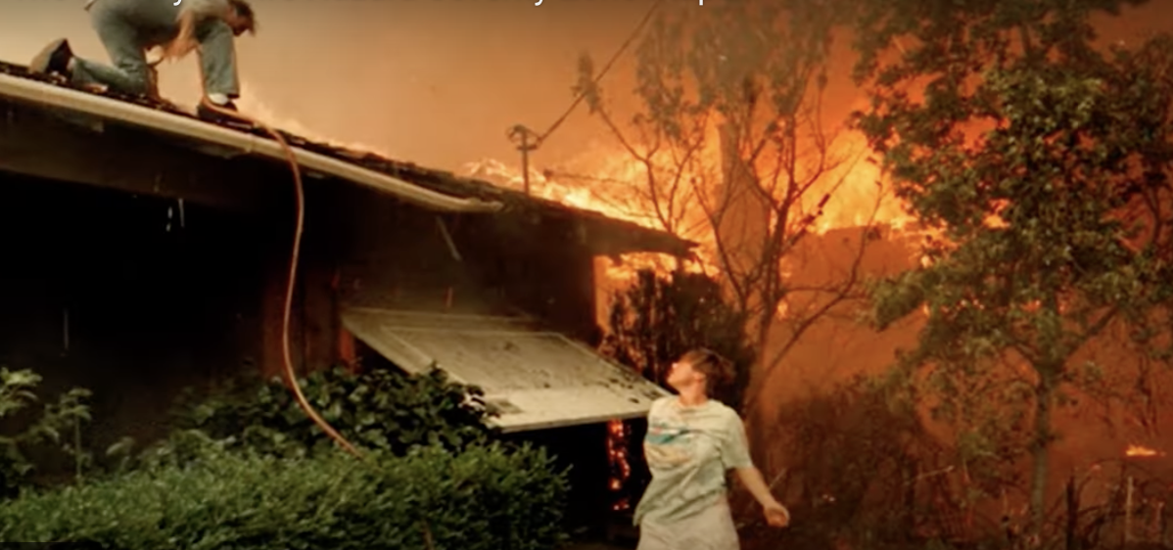
History
1980 Panorama Fire (San Bernardino County)
4 Deaths
325 Structures
1981 California Public Resources Code 4201-4204
Required Fire Hazard Severity Maps for SRA
1985 First maps released
Danger rating approach based number of days per year of high burning index
1991 Tunnel Fire
25 deaths
3000 structures

Slide 3
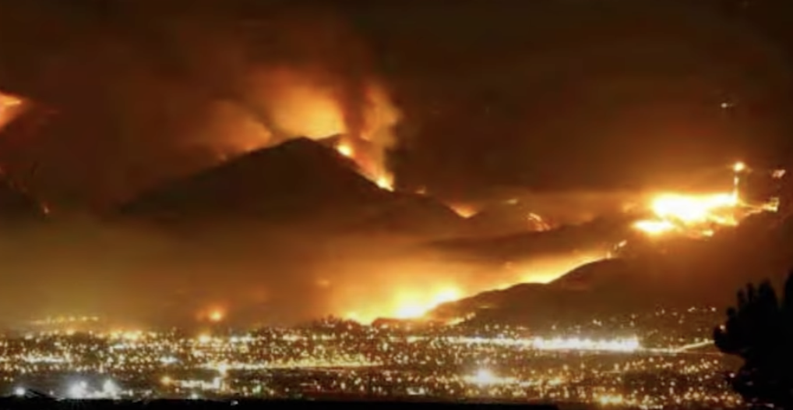
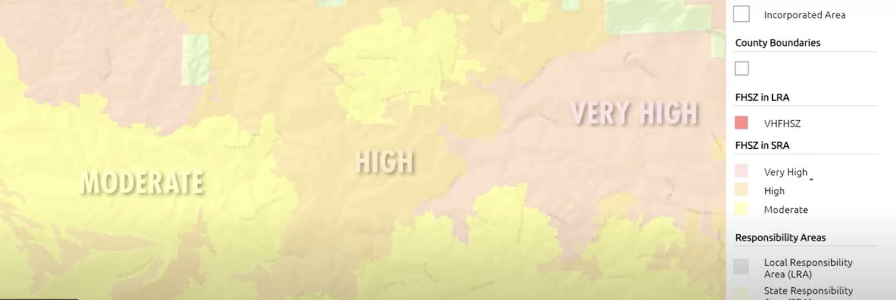
History
1992 Bates Law
Required Fire Hazard Severity Zones in LRA
Vegetation
Terrain
Fire History
Access
Egress
2007 Fire Resource Assessment Program (FRAP) completed statewide maps for SRA
Moderate
High
Very High
Fire history
Vegetation
Predicted Flame Length
Embers
Terrain
2011 FRAP competed maps for LRA

Slide 4
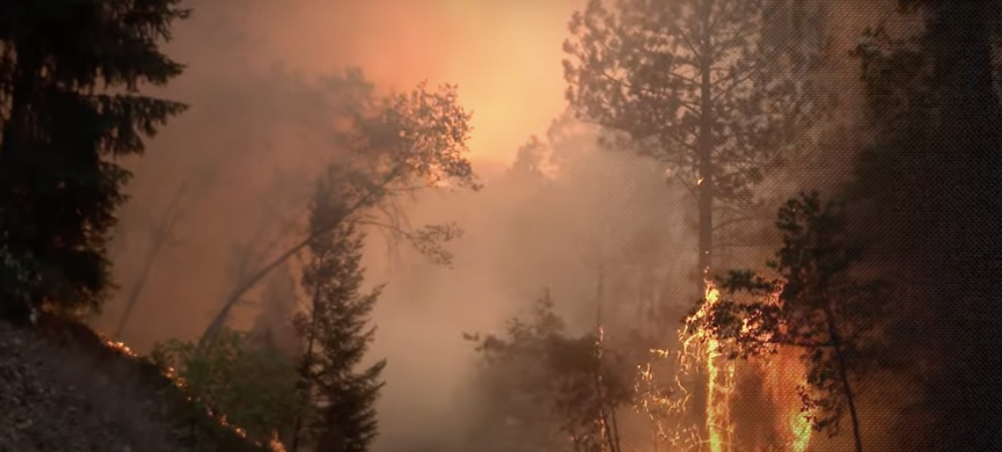
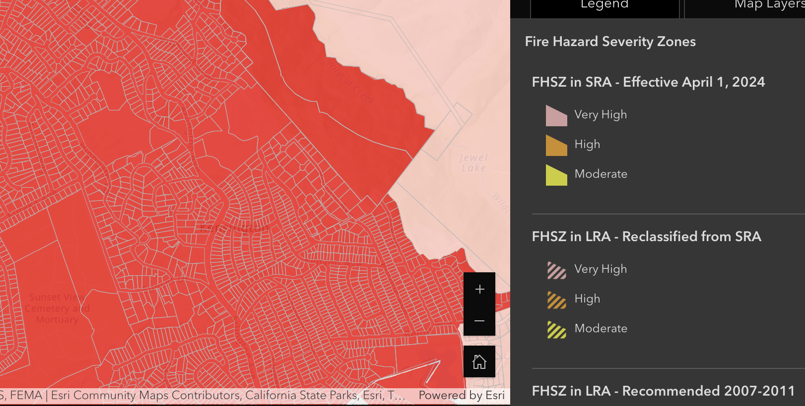
History
2012 - SB 1241
Required mitigation planning in long range planning documents
2021 – SB 63 requires the fire hazard severity zones maps in LRA
Maps updates
SRA April 2024
LRA estimated at end of 2024

Slide 5
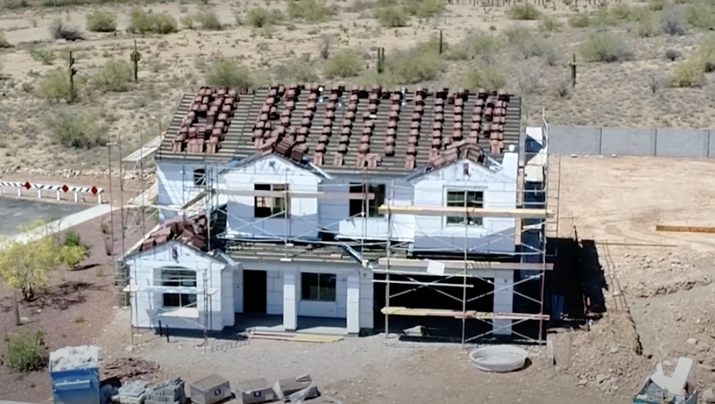
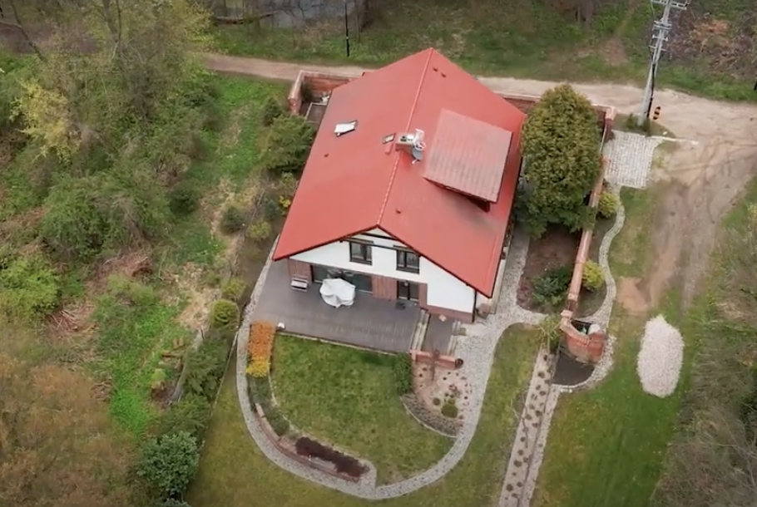
Fire Hazard Severity Zones
Hazard – NOT Risk
Hazard = Physical conditions that produce likely hood of fire over a 30 to 50 year period.
Blind to any short term modification; building codes, fuel reduction, ETC.
Risk is a combination of Hazards, Consequences, and Vulnerability
Hazard Score = Zones – Average of score
Flame length
Embers
Likelihood of area burning
Not a Structure Loss Model

Slide 6
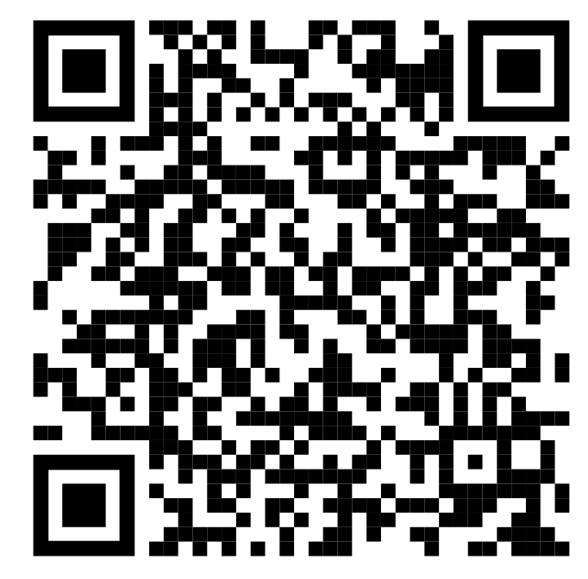
Fire Hazard Severity Zones
Influence
New building codes
Disclosures at time of sale
100 foot defensible space around buildings
Area new development
Road width
Signage
Water supply
Maps can be viewed at
https://experience.arcgis.com/experience/03beab8511814e79a0e4eabf0d3e7247/

Slide 7
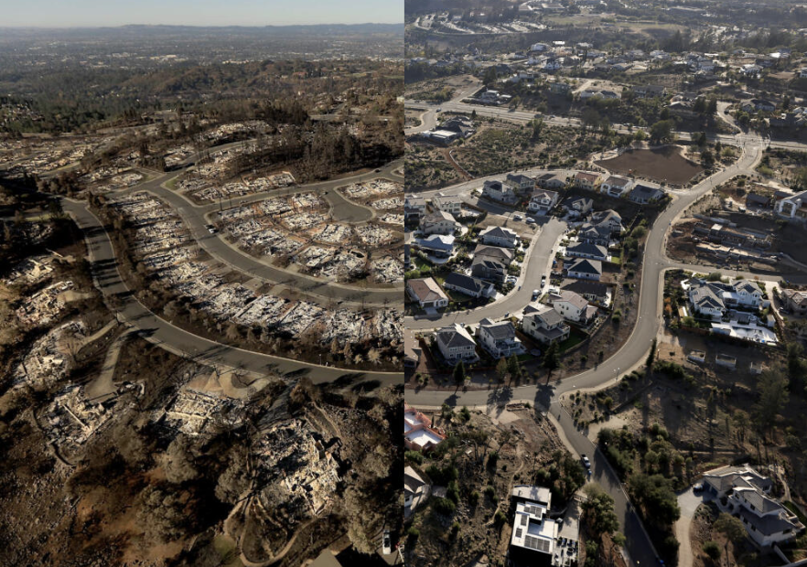
Risk – Insurance Models
Threats – Consequences – Vulnerabilities (TCV)
Threat close to Hazards
Don’t consider Zones
Consequences
Life and Property in $
Vulnerabilities
Response models
Mitigation actions

Slide 8
Thank you for Support And Partnership

