Slide 1
El Cerrito Kensington Fire Department
Enhance community safety by reducing loss of life and property and safeguarding the environment
Effectively respond to fires, rescues, and medical emergencies, hazardous material incidents, and major disasters
Core functions include:
Fire Suppression
Emergency Medical Response
Code Enforcement and Fire Inspections
Vegetation Reduction
Public Education and Outreach

Slide 2
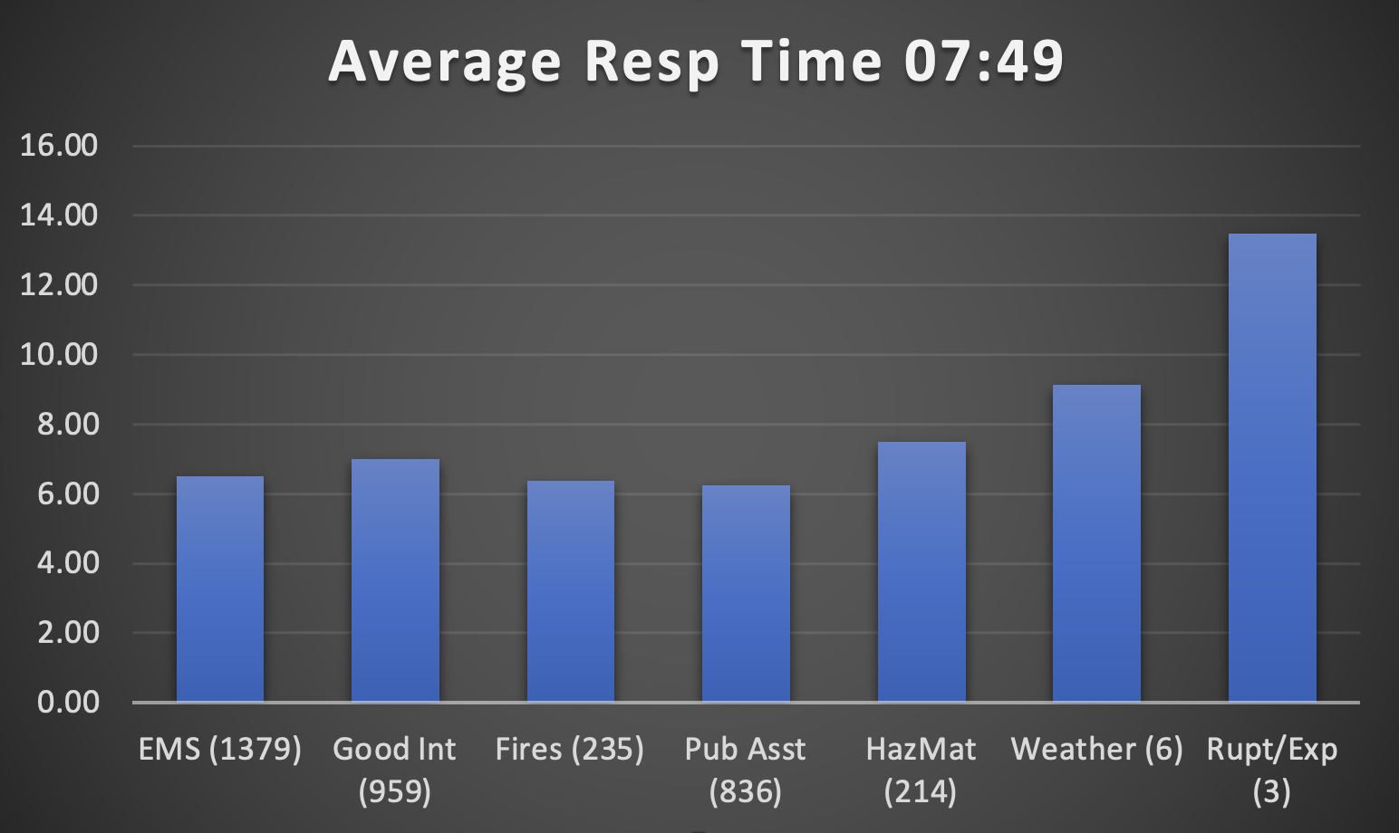
Department Overview and Staffing
FIRE DEPARTMENT | FY 2021-22 | FY 2022-23 | FY 2023-24 | FY 2024-25 | FY 2025-26
Fire Chief | 1 | 1 | 1 | 1 | 1
Executive Administrative Assistant | 1 | 1 | 1 | 1 | 1
Battalion Chief | 3 | 3 | 3 | 3 | 3
Battalion Chief/Training Officer | 1 | 1 | 1 | 1 | 1
Fire Captain | 2 | 2 | 2 | 2 | 2
Fire Captain/Paramedic | 7 | 7 | 7 | 7 | 7
Fire Captain/Paramedic/FPO | 1 | 1 | 1 | 1 | 1
Fire Engineer | 5 | 5 | 5 | 5 | 5
Fire Engineer/Paramedic | 7 | 7 | 7 | 7 | 7
Firefighter | 6 | 6 | 6 | 6 | 6
Firefighter/Paramedic | 3 | 3 | 3 | 3 | 3
Civilian Fire Marshall | 0 | 0 | 0.5 | 0.5 | 0.5
FIRE DEPARTMENT TOTAL | 37 | 37 | 37.5 | 37.5 | 37.5

Slide 3
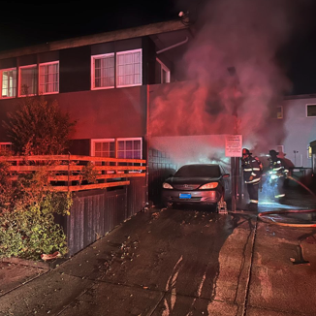
FY 2023-24 Highlights and Accomplishments
Administration
Enhanced automatic aid agreements with regional partners
Hired three firefighters
Submitted grants for new self-contained breathing apparatus (SCBA) for 400,000 dollars
Saved $17,801,300 in property value in El Cerrito and Kensington
Training
Exercised the Emergency Operations Plan during a three-day earthquake drill
Completed trench rescue training
Completed a joint fire academy with Richmond Fire
Public Outreach
Partnered with Lamorinda for CERT training
El Cerrito/Kensington’s CERT program
Hosted Tri-City Safety Day and CPR classes

Slide 4
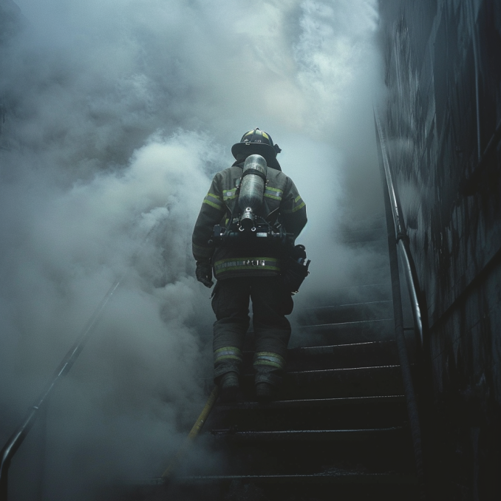
FY 2024-25 and FY 2025-26 Focus/Workplan
Administration
Purchase new EKG monitors
Complete our Records Management system (RMS) upgrade
Training
Compete high-rise training and wildland drill with regional partners
Host an Earthquake exercise with regional partners
Host seven CERT classes to expand the team
Operations
Maintain response times below 8 minutes
Develop a regional SOG for electric vehicle fires
Develop a regional SOG for Active Shooter/IMCI events
Enhance our shared response with Berkeley, Albany, Richmond, and Con Fire to decrease response times

